Slide 1

Unit Testing your JavaScript
Aris Markogiannakis
City University - Short Courses
CS3606 : JavaScript 2: Advanced Javascript for Websites and Web

Slide 2
Today
Unit Tests?
Examples
Create our own Unit Tests using libraries such as Mocha, Chai, Sinon

Slide 3

Have you been there?
Spend a day trying to find
what was changed on my
code
How could I have avoided this?
If you had written some unit
tests you should have been able
to find what was changed, as unit
test suppose to check was what the
expected

Slide 4
Testing frameworks, libraries and utilities
Mocha (mochajs.org) OS framework runs on top of node.js
It uses Assertion libraries
We first need to make sure we have node on our machine
node –v to get the current version of node
npm install mocha --save-dev
Create a test folder and then inside a test.js file

Slide 5
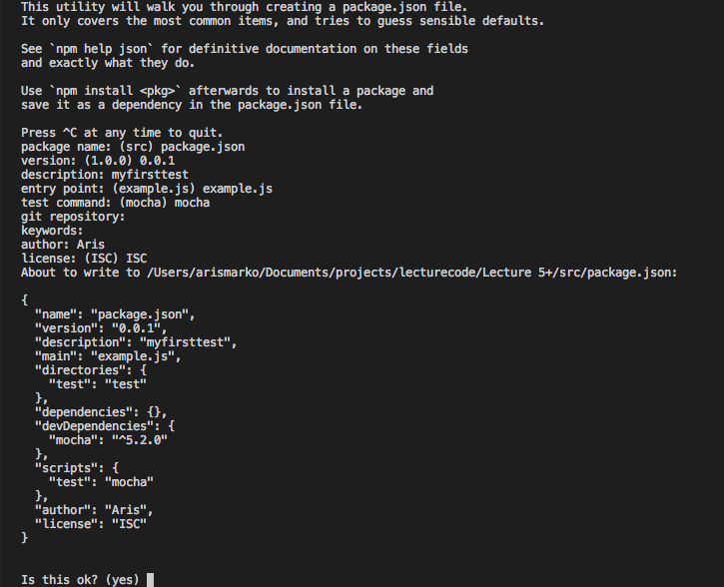
Get Started
To get started we need to setup our environment
Create a folder called myfirst-js-tdd
Inside the folder lets first setup our environment
run npm init - you should be able to see my example on the right.
Then lets install mocha
npm install mocha - - save - dev

Slide 6
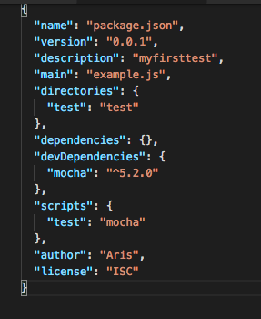
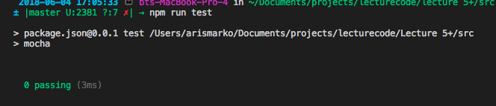
Get Started
Run our test for the first time
Create a folder called test and inside add a file called tests.js
You can run your tests by
npm run test
You will see the following:

Slide 7
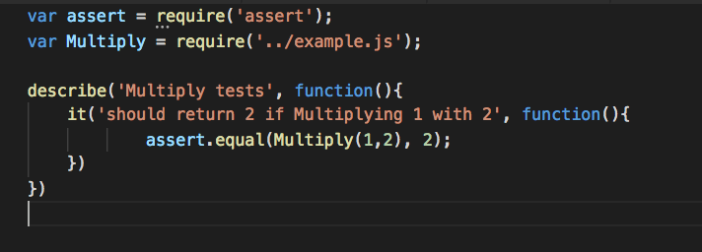
Describe
Describe is a testing suite
It takes two arguments:
a string "name of the suite",
and a function,
takes a function called it which also takes two arguments,
what the code should do,
and a function where we write our tests
A simple test can be seen on the right
We use assert to check that a condition is right.

Slide 8
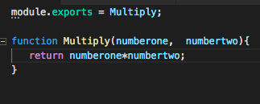
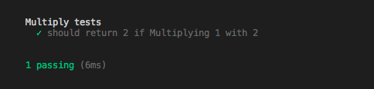
Checking against our code
So if we write some code
So now if we try to change our code we should always be able to see if something went wrong.

Slide 9
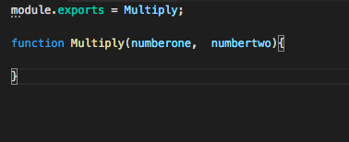
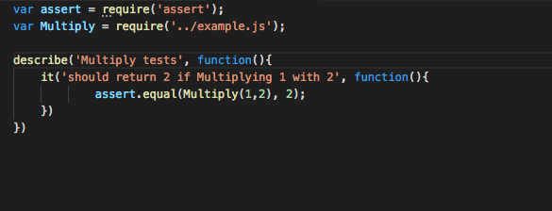
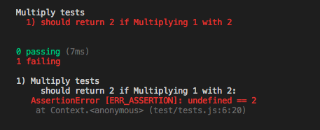
Checking against our code
Now is time to check against our code
Imagine we will need to write a code that will implement a multiplication
We will write first our test
As you can see we are importing our Multiply function
Then inside the code we are using the Multiply function together with the assert method to check if the result is correct.
If we try to run it we will get the following output
We get 0 passing
And 1 failing - you know why?

Slide 10
Chai
You can read more about Chai on the website Chai.js
Mocha is a testing framework, and Chai is an assertion library.
We can use Chai with Mocha
Prepare our environment
For this we need to install
npm install chai - - save - dev

Slide 11
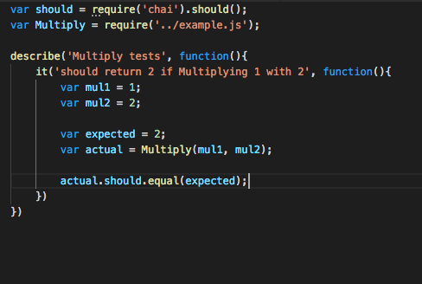
Should
So our first try we will import chai and the method should
Then in our code we have two variables mul1, and mul2, and then what is expected and what is the actual from our method.
Then we use our should
actual.should.equal(expected)
We can also use it as
actual.should.not.equal
Notes:
Change ACTUAL TO RESULT

Slide 12
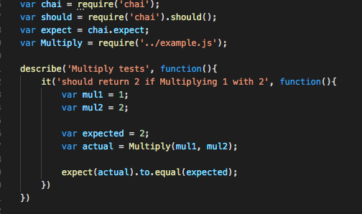
Expect
The expect is a bit different

Slide 13
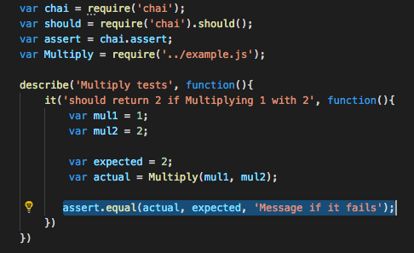
Assert
You can also use
assert.equal(actual, expected, 'Message if it fails');
assert.not.equal(actual, expected, 'Message if it fails');

Slide 14
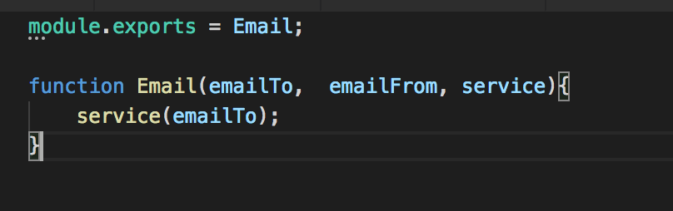
Sinon
Another JavaScript testing library
Its purpose is to help us to write tests if you are trying to access for some more advanced code like API's
e.g. You can mock a server for example when you enter the details for
Imaging the function on the right an email service where there is a function that will send an email to and email from

Slide 15
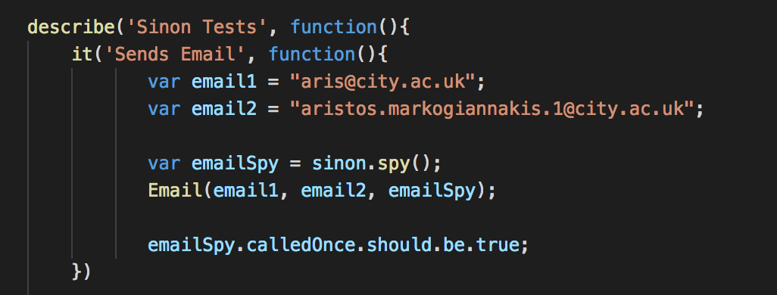
Spies
With spies we can test the function that we call, and our test will try to see at the end of the code the service function was called twice
Try to comment out the line where we execute the service method.

Slide 16
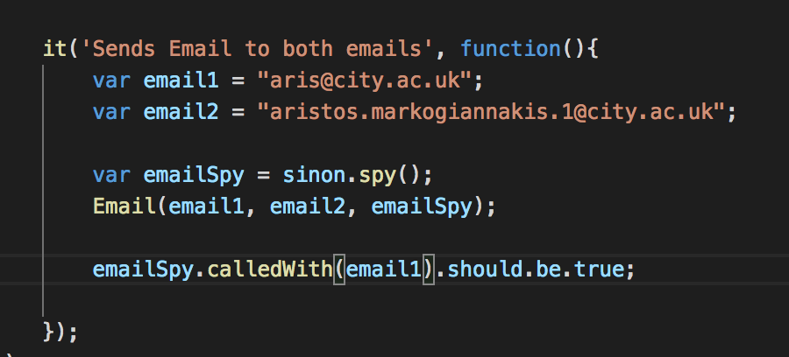
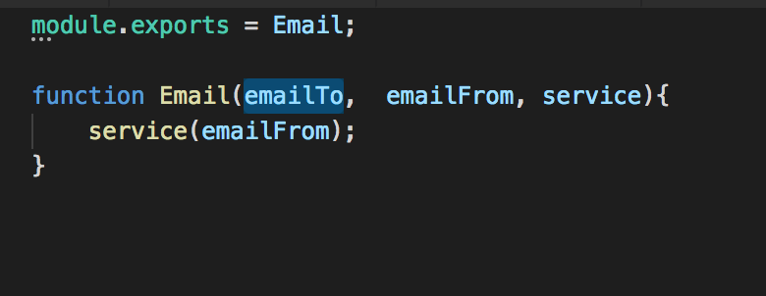
Spies
We can also test that the spy method has been called with a certain argument
What if we were going to change and this time send the email to email2?

Slide 17
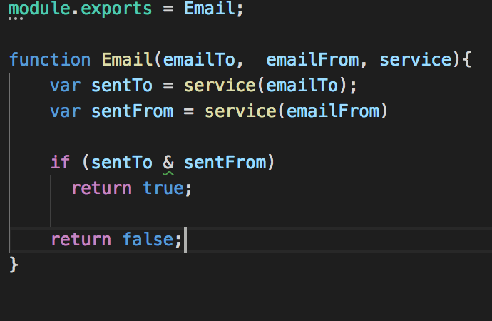
Stubs
Sinon Stubs can be used to make sure that a certain value has returned,
For example in our example imagine we had to send the email twice if all emails have been sent then the function would return true

Slide 18
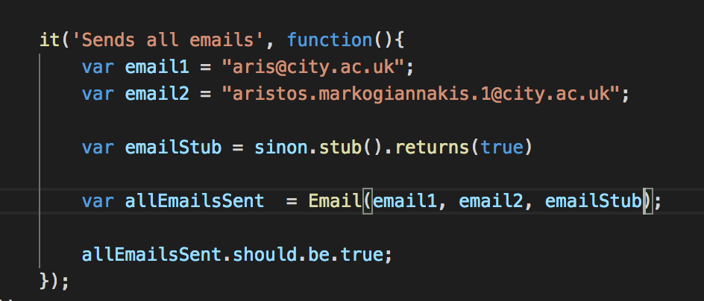
Stub
So now we will implement our stub,
We have created a stub, that we expect to return true
On our code we have to send where we expect when those email are sent to receive a true.
If all those return true then the allEmailsSent will return true.

Slide 19
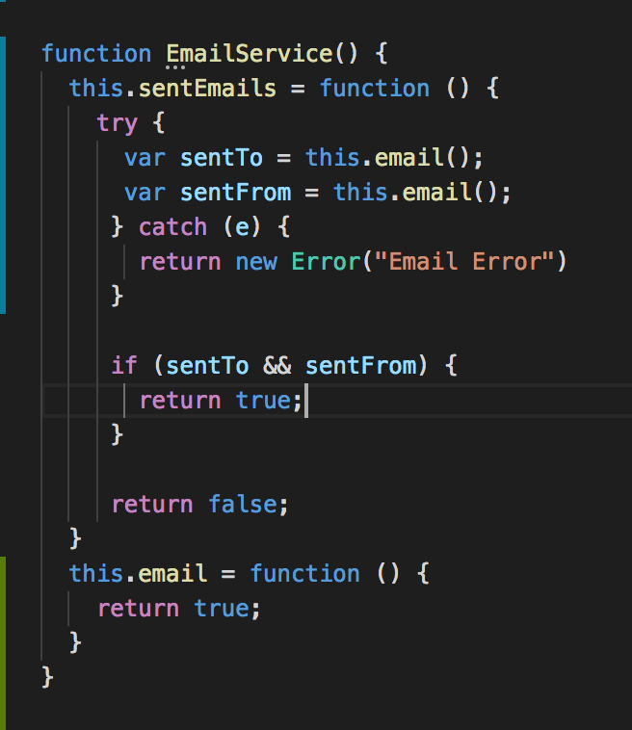
Mock
We can use Mock to mock an object, in our case we can change the code to create a Mock object
Imaging the class on the right where we have an EmailService
What we want to test is when we run our sentEmails the email method was executed twice.

Slide 20
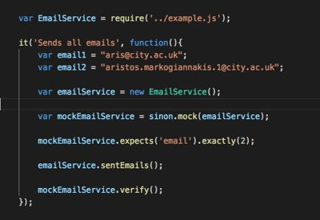
Mock that object!
We will import the EmailService and then using sinon.mock we will add the object we want to mock.
We will then take the mock and declare the function that we expect to run twice!
We will run the method from the original object
And then verify.

Slide 21
Further resources
Check mochajs.org for more information on Mocha
Check chaijs.com for more information on Chai
Check sinon.js website for more information on Sinon
When we start doing React will also visit Enzyme

